Slide 1
HOUSING: PRICE PREDICTION
Submitted by: Harneet Kaur Rehsi

Slide 2
Problem Statement : Houses are one of the necessary need of each and every person around the globe and therefore housing and real estate market is one of the markets which is one of the major contributors in the world’s economy. It is a very large market and there are various companies working in the domain. Data science comes as a very important tool to solve problems in the domain to help the companies increase their overall revenue, profits, improving their marketing strategies and focusing on changing trends in house sales and purchases. Predictive modelling, Market mix modelling, recommendation systems are some of the machine learning techniques used for achieving the business goals for housing companies. Our problem is related to one such housing company. A US-based housing company named Surprise Housing has decided to enter the Australian market. The company uses data analytics to purchase houses at a price below their actual values and flip them at a higher price. For the same purpose, the company has collected a data set from the sale of houses in Australia. The data is provided in the CSV file below. The company is looking at prospective properties to buy houses to enter the market. You are required to build a model using Machine Learning in order to predict the actual value of the prospective properties and decide whether to invest in them or not. For this company wants to know: • Which variables are important to predict the price of variable? • How do these variables describe the price of the house?
• Business Problem Framing: Houses are one of the necessary need of each and every person around the globe and therefore housing and real estate market is one of the markets which is one of the major contributors in the world’s economy. It is a very large market and there are various companies working in the domain
• Motivation for the Problem Undertaken: This model will then be used by the management to understand how exactly the prices vary with the variables. They can accordingly manipulate the strategy of the firm and concentrate on areas that will yield high returns. Further, the model will be a good way for the management to understand the pricing dynamics of a new market.

Slide 3
Train dataset
 | Id | MSSubClass | MSZoning | LotFrontage | LotArea | Street | Alley | LotShape | LandContour | Utilities | ... | PoolArea | PoolQC | Fence | MiscFeature | MiscVal | MoSold | YrSold | SaleType | SaleCondition | SalePrice
0 | 1 | 60 | RL | 65.0 | 8450 | Pave | NaN | Reg | Lvl | AllPub | ... | 0 | NaN | NaN | NaN | 0 | 2 | 2008 | WD | Normal | 208500
1 | 2 | 20 | RL | 80.0 | 9600 | Pave | NaN | Reg | Lvl | AllPub | ... | 0 | NaN | NaN | NaN | 0 | 5 | 2007 | WD | Normal | 181500
2 | 3 | 60 | RL | 68.0 | 11250 | Pave | NaN | IR1 | Lvl | AllPub | ... | 0 | NaN | NaN | NaN | 0 | 9 | 2008 | WD | Normal | 223500
3 | 4 | 70 | RL | 60.0 | 9550 | Pave | NaN | IR1 | Lvl | AllPub | ... | 0 | NaN | NaN | NaN | 0 | 2 | 2006 | WD | Abnorml | 140000
4 | 5 | 60 | RL | 84.0 | 14260 | Pave | NaN | IR1 | Lvl | AllPub | ... | 0 | NaN | NaN | NaN | 0 | 12 | 2008 | WD | Normal | 250000

Slide 4
Test dataset
Id | MSSubClass | MSZoning | LotFrontage | LotArea | Street | Alley | LotShape | LandContour | Utilities | ... | ScreenPorch | PoolArea | PoolQC | Fence | MiscFeature | MiscVal | MoSold | YrSold | SaleType | SaleCondition
0 | 1461 | 20 | RH | 80.0 | 11622 | Pave | NaN | Reg | Lvl | AllPub | ... | 120 | 0 | NaN | MnPrv | NaN | 0 | 6 | 2010 | WD | Normal
1 | 1462 | 20 | RL | 81.0 | 14267 | Pave | NaN | IR1 | Lvl | AllPub | ... | 0 | 0 | NaN | NaN | Gar2 | 12500 | 6 | 2010 | WD | Normal
2 | 1463 | 60 | RL | 74.0 | 13830 | Pave | NaN | IR1 | Lvl | AllPub | ... | 0 | 0 | NaN | MnPrv | NaN | 0 | 3 | 2010 | WD | Normal
3 | 1464 | 60 | RL | 78.0 | 9978 | Pave | NaN | IR1 | Lvl | AllPub | ... | 0 | 0 | NaN | NaN | NaN | 0 | 6 | 2010 | WD | Normal
4 | 1465 | 120 | RL | 43.0 | 5005 | Pave | NaN | IR1 | HLS | AllPub | ... | 144 | 0 | NaN | NaN | NaN | 0 | 1 | 2010 | WD | Normal

Slide 5
Visualization using EDA

Slide 6
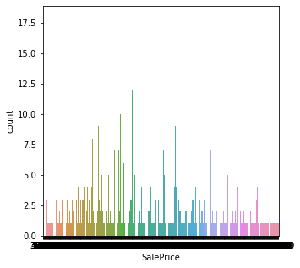
Countplot
Used countplot for observing SalePrice

Slide 7
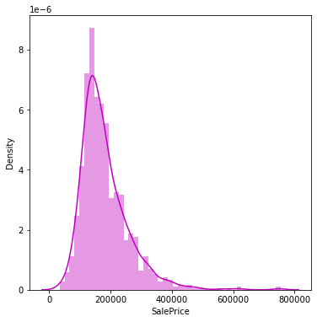
Distplot
Used distplot on SalePrice to check the skewness of the data. the data is not skeweed as the curve its making is a bell shape curve.

Slide 8
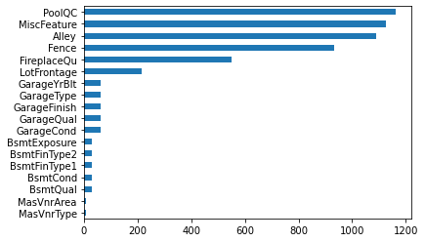
Horizontal bar plot
Here it is showing the features containing null values and the features containing the most and the least null values

Slide 9
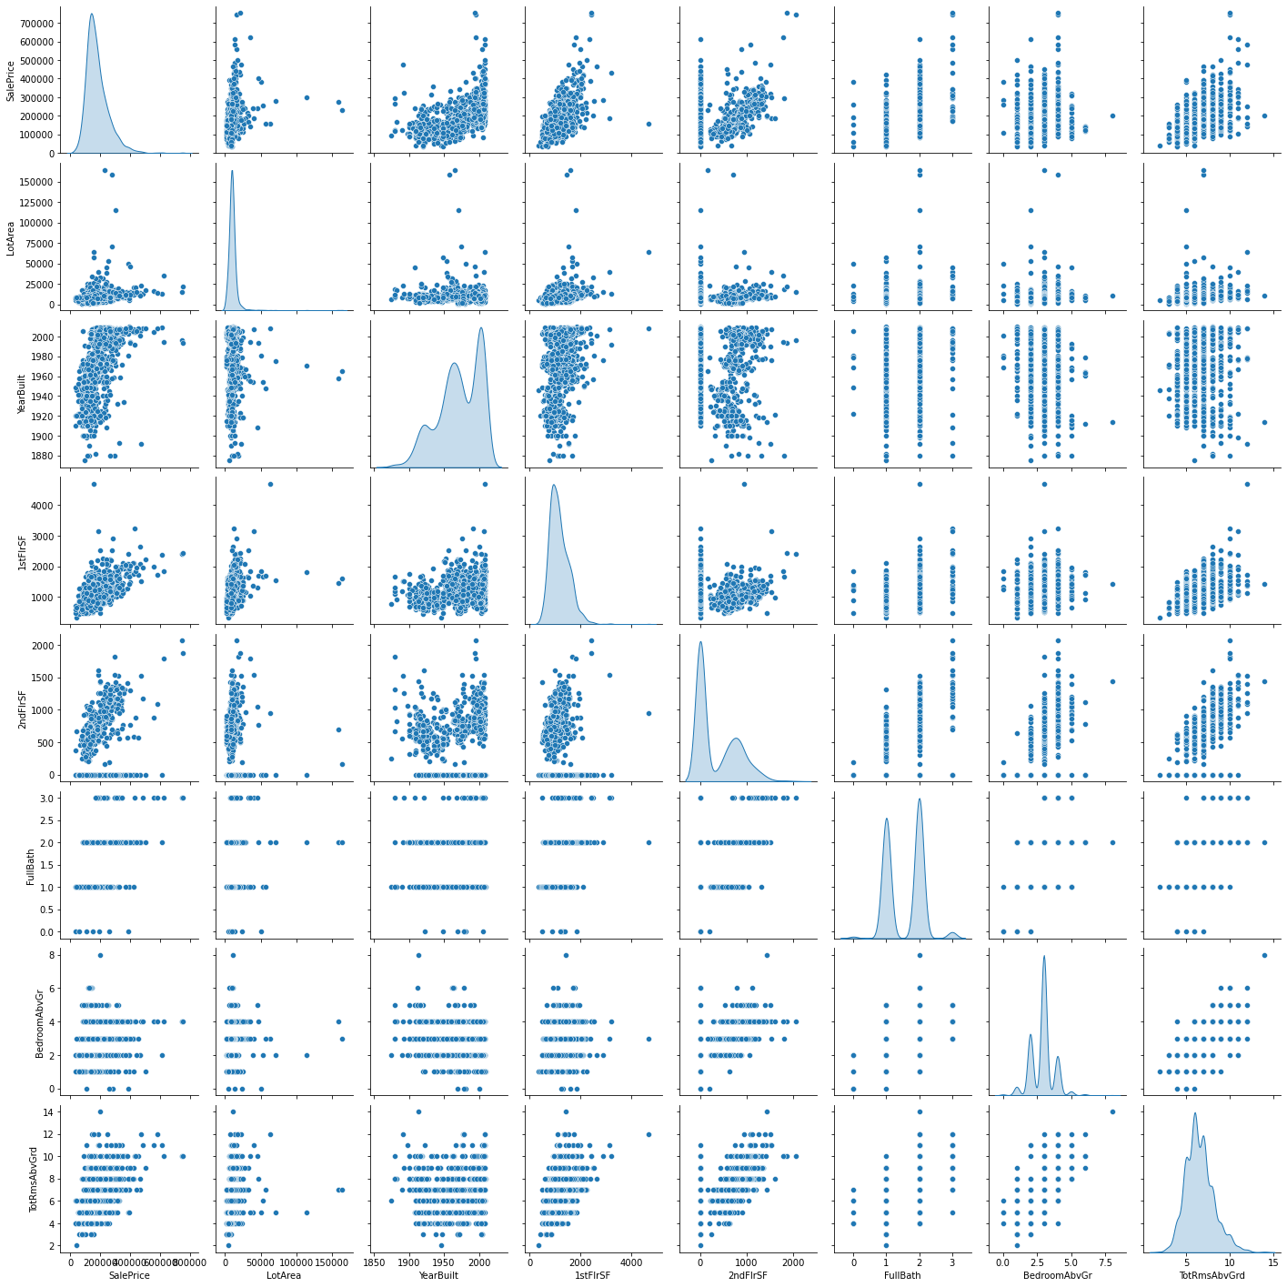
Pairplot
Used pair plot for some features ["SalePrice", "LotArea", "YearBuilt", "1stFlrSF", "2ndFlrSF", "FullBath", "BedroomAbvGr", "TotRmsAbvGrd"]

Slide 10
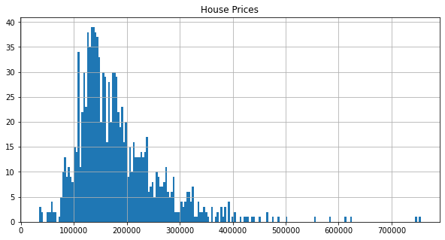
Histogram
Used histogram for observing SalePrice

Slide 11
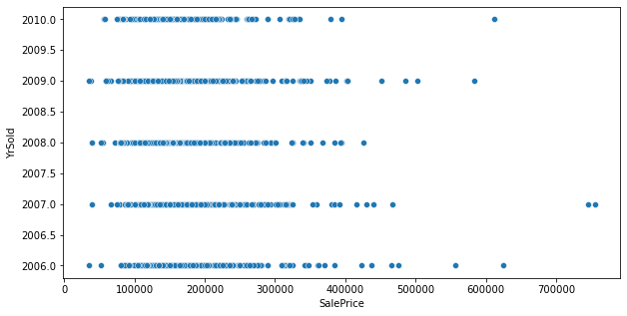
Scatterplot
Used scatterplot and check the relationship between ‘saleprice’ and ‘yrsold’ .

Slide 12
Tools and libraries
• import pandas as pd
• import numpy as np
• pd.set_option('display.max_columns', 100)
• pd.set_option('display.max_rows', 100)
• import warnings • warnings.filterwarnings('ignore’)
• import matplotlib.pyplot as plt
• import seaborn as sns
• %matplotlib inline
• from sklearn.model_selection import train_test_split
• from sklearn.linear_model import LinearRegression
• from sklearn.tree import DecisionTreeRegressor
• from sklearn.linear_model import Ridge
• from sklearn.linear_model import Lasso
• from sklearn.preprocessing import LabelEncode

Slide 13
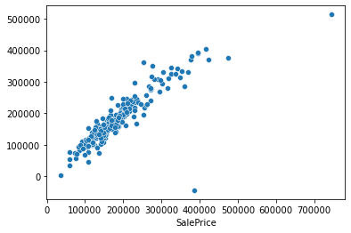
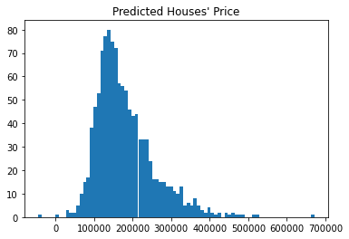
Predicted house price

Slide 14
Conclusion
We started this data science project with a seemingly simple question — “What is the price of this property? How can we improve our price estimations?”. After gathering data and a significant amount of time was spent cleaning the data and extracting the features needed for modeling. We tested multiple variations of regression models, including Linear regression, Decision tree regressor, using Lasso for checking if the model is overfitted. MEAN SQUARED ERROR, MEAN ABSOLUTE ERROR, ROOT MEAN SQUARED ERROR for calculating the mean of error. Two models that used different combinations of features were trained for this project — it is helpful to compare them side by side.

